Slide 1

Automated Machine Learning Random forest And Shap Values
Varadharajan Suresh
vs2769

Slide 2

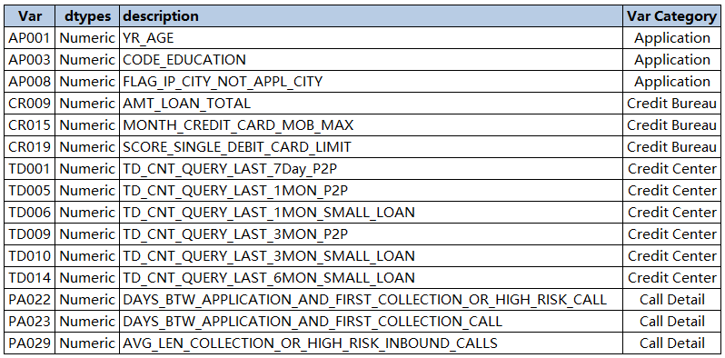

EDA
Data Dictionary
Newly created features
AP001_D_WOE, AP003_D_WOE, AP008_D_WOE, CR009_D_WOE, CR015_D_WOE,CR019_D_WOE, PA022_D_WOE, PA023_D_WOE, PA029_D_WOE,TD001_D_WOE, TD005_D_WOE, TD006_D_WOE, TD009_D_WOE,TD010_D_WOE, TD014_D_WOE

Slide 3
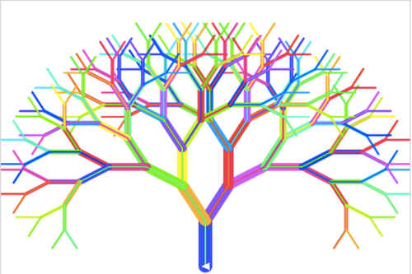
Modelling
What is Random Forest?
Random forest is a technique used in modeling predictions and behavior analysis and is built on decision trees. It contains many decision trees representing a distinct instance of the classification of data input into the random forest. The random forest technique considers the instances individually, taking the one with the majority of votes as the selected prediction.

Slide 4
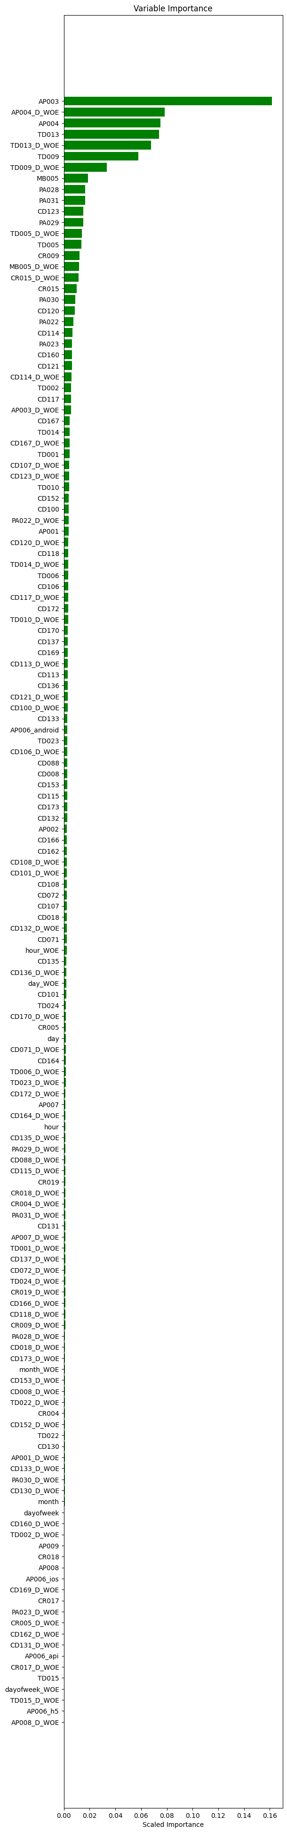
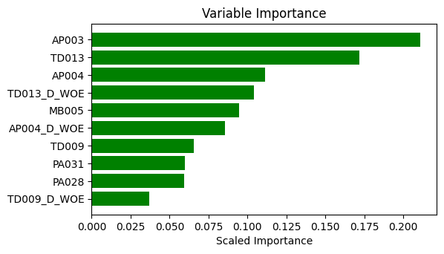
RF Models
Model 1 - Feature Importance
Model 2 - Feature Importance

Slide 5
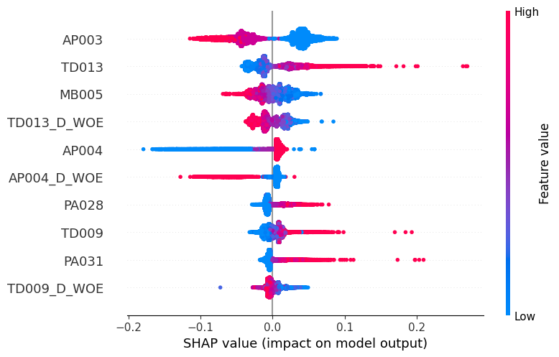
SHAP
Summary Plot

Slide 6
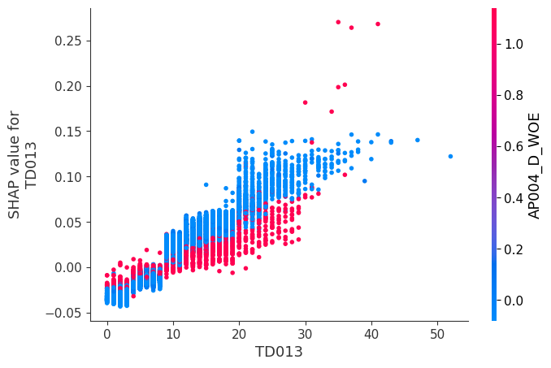
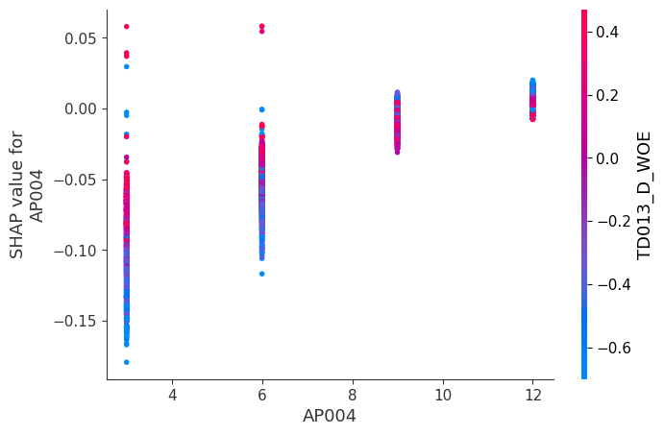
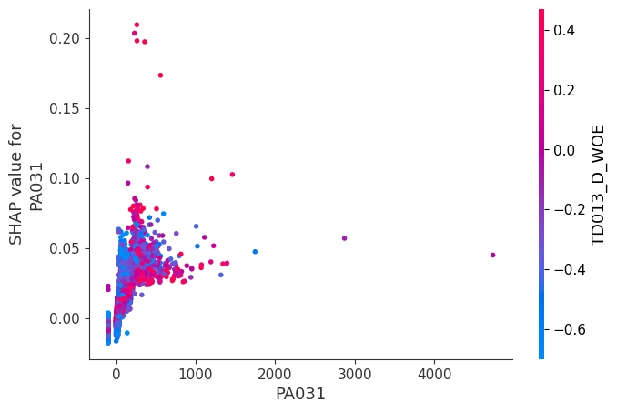
SHAP
Dependence Plot

Slide 7
SHAP
Force Plots

Slide 8


Thank you

